Slide 1
Getting Started with HTML CSS and JavaScript
Notes:
We'll kick off the course with an overview of some essential HTML, CSS, and JavaScript concepts and theory. The focus of the course is very definitely on HTML5, and CSS3 is an important related standard. JavaScript plays a major supporting role in all this, because a lot of the new HTML5 features require you to write JavaScript code ☺.

Slide 2
Contents
Setting the scene
Working with HTML documents
Using the HTML5 selector API
Annex
Using Modernizr
Demos folder:
Demos\01-GettingStarted
Notes:
Section 1 sets the scene for the chapter. We'll summarize what HTML5 and CSS3 are all about, and where they came from.
Section 2 runs through some core HTML theory, and recaps how you can access content in an HTML document using various traditional HTML APIs.
Section 3 discusses the HTML5 selector API, which is a new and improved way for locating content in an HTML document.
The Annex at the end of the chapter discusses Modernizr, an open-source JavaScript library that makes it easier to detect a browser's support for HTML5 features. Several chapters in the course have such Annex sections, containing optional additional information. We won’t plan to cover these Annexes during the course, but if you have a particular interest, feel free to ask the instructor ☺.
Note: Each chapter in this course has a dedicated set of demo code and lab code. The demos for this particular chapter are located in the 01-GettingStarted sub-folder. So, if the course code is installed in the standard location, you'll find the demos for this chapter here:
C:\Html5Css3JsDev\Demos\01-GettingStarted

Slide 3
1. Setting the Scene
Overview of HTML
New features in HTML5
Some simplifications in HTML5
Overview of CSS
Organizing CSS styles
Overview of JavaScript
Adding JavaScript to an HTML page
Deferred execution
Notes:
This section recaps some essential HTML, CSS, and JavaScript concepts. We'll also summarize the new features available in HTML5 and CSS3.

Slide 4
Overview of HTML
1999: HTML4 emerged in 1999
Standardized by the Worldwide Web Consortium (W3C)
2000: XHTML 1.0 was introduced
An XML-compliant version of HTML
2004: WHATWG formed
Web Hypertext Applications Technology Working Group
Tasked to extend the meaningful life of HTML
2007: HTML5 concept launched
W3C and WHATWG formed a working group to develop the HTML5 specification
Notes:
HTML5 is a major evolution of the HTML standard. It's not just a set of new tags - there's an extensive JavaScript API involved too, plus major enhancements to CSS. It's a big game changer!

Slide 5
New Features in HTML5
HTML5 introduces the following new features:
Native audio and video
New input controls
Graphics (canvas and SVG)
Geolocation
Web sockets
Web storage
Web workers
Ajax improvements
Plus lots of other nice things!
Notes:
This slide summarizes some of the major new features available in HTML5. We'll discuss all these topics during this chapter, plus lots of minor API improvements and a clutch of new tags that make Web development easier and more standardized than ever before.

Slide 6
Some Simplifications in HTML5
DOCTYPE declarations have been simplified
From this:
To this ☺:
Character set declarations have also been simplified
From this:
To this ☺:
<!DOCTYPE HTML PUBLIC "-//W3C//DTD HTML 4.01 Transitional//EN"
"http://www.w3.org/TR/html4/loose.dtd">
<!DOCTYPE html>
<meta http-equiv="Content-Type" content="text/html; charset=utf-8">
<meta charset="utf-8">
Notes:
This slide summarizes a few simple ways in which the HTML5 specification simplifies the structure of an HTML document. Nothing too exciting here, but nice to know!

Slide 7
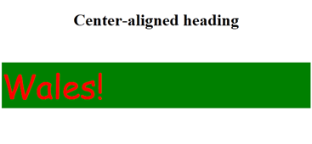
Overview of CSS
CSS was introduced in HTML 4, to allow you to define styles for HTML elements
CSS3 appeared alongside HTML 5, with new features such as transformations, animations, etc.
Here's a simple CSS example, which defines inline styles
Set the style attribute directly on an HTML element
See UsingSimpleStyles.html
<h1 style="text-align:center;">Center-aligned heading</h1>
<p style="font-family: comic sans ms; color: red; background-color: green; font-size: 48pt">
Wales!
</p>
Notes:
The example in the slide shows how to use simple CSS styles to change the appearance of various elements in a Web page. You can view this example for yourself - open UsingSimpleStyles.html in a browser (e.g. Chrome, Internet Explorer, Firefox, etc.).
This example shows simple CSS2 styles. There's nothing new here. But CSS has moved on, and the CSS3 specification introduces a wide range of powerful new features such as animations, drop shadows, etc. We'll explore these new features in detail during this course.

Slide 8
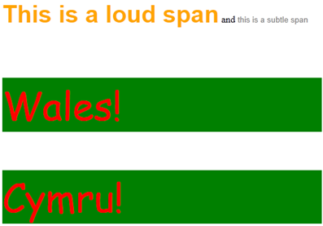
Organizing CSS Styles
You can define styles in <style> elements
E.g. define styles that apply to tag names
E.g. define styles that apply to tags of a certain class
See UsingStyleElements.html
You can also link to an external style sheet, as follows:
<style>
p {
color: red;
…
}
.loud {
color: orange;
…
}
…
</style>
<link rel="stylesheet" type="text/css" href="styles/MyStylesheet.css"/>
Notes:
The example in the previous slide showed how to define CSS styles inline, as part of an element definition. A better approach is to define styles globally, either at the top of the Web page or in a dedicated CSS style sheet file.

Slide 9
Overview of JavaScript
JavaScript is a scripting language
Usually embedded directly (or linked) into HTML pages
Uses of JavaScript:
Make HTML pages interactive
React to events
Update the content of the HTML document
Validate data before it is submitted to a server, to save unnecessary roundtrips
Notes:
In order to get the most out of HTML5, it's essential that you can program in JavaScript. For example, you need to know how to handle events (mouse hover, key presses, etc.), locate content in the Web page, add new content, instigate Ajax calls to the Web server, etc.

Slide 10
Adding JavaScript to an HTML Page
To add JavaScript to an HTML page:
Use the <script> tag
You can place JavaScript in an external file
Conventional to use the .js file extension
Enables you to share script across multiple HTML pages
In the web page, use a <script> tag with a src attribute
<script type="text/javascript"> document.write("<h1>Here is some dynamic content.</h1>");
</script>
UsingSimpleScript.html
document.write("Hello from MyScriptFile.js");
MyScriptFile.js
<body>
<script type="text/javascript" src="MyScriptFile.js"></script> </body>
UsingExternalScript.html
Notes:
The upper code box in the slide shows JavaScript code embedded in a Web page. This can be OK on occasion, but generally it's better to place JavaScript code in a separate file as shown in the middle code box. The lower code box shows how to include a JavaScript file in your Web page.
Remember, all these files are in the demo folder on your computer, so feel free to open these files and/or run them to see the overall effect.

Slide 11
Deferred Execution
If you want JavaScript to be executed only when they are called, or when an event happens…
Put the JavaScript in a function, typically in the <head>
Ordering doesn't matter
<html>
<head>
<script type="text/javascript"> function message() { alert("This alert box was called with the onload event"); } </script>
</head> <body onload="message()"> </body>
</html>
DeferredExecution.html
Notes:
The example JavaScript code on the previous slide is executed while the page is loading. This is known as immediate execution. Generally, a better approach is to use deferred execution, whereby JavaScript code is only invoked in response to an event (e.g. page load completed, button clicked, etc.).
The example in the slide shows deferred execution. The message() function will only be invoked after the page has completely loaded.

Slide 12
2. Working with HTML Documents
HTML document structure
HTML DOM objects
Locating document content
Navigating document content
Modifying document content
Accessing form content
Notes:
In this section we're going to review traditional techniques for manipulating HTML content in a Web page. This isn't new in HTML5, but it's important you understand all this before we move on.

Slide 13
HTML Document Structure
Consider this simple HTML document
The browser parses this HTML and creates a model
The model preserves the hierarchy of the HTML elements
This is known as the Document Object Model (DOM)
<html>
<head>
<title>This is my simple page</title>
<meta name="author" content="John Smith"/>
<meta name="description" content="Simple example"/>
</head>
<body>
<p id="intro">This is the intro to my page</p>
<p id="main">This is the <b>main</b> content in my document</p>
</body>
</html>
html
head
body
title
meta
meta
p
p
b
Notes:
When a browser loads an HTML document, it builds a DOM tree. The DOM tree contains objects that represent all the nodes in the document. You can then write JavaScript code to access objects in this tree, add new objects, change object attributes, etc.

Slide 14
HTML DOM Objects
Here are some of the HTML DOM objects in JavaScript:
document
Accessible via window.document
Provides access to all the HTML elements in the current page
form
Represents a <form> element in the current page
Has an elements[] property, containing all HTML elements in the form
Has submit() and reset() methods
text
Represents a text input field
Useful properties: value, size, maxLength, readOnly, disabled, etc.
Useful methods: blur(), focus(), select()
button
Represents a button ☺
Useful properties: value, disabled, etc.
Etc…
Notes:
The DOM API contains many standard objects to represent the different types of element you can have in a Web page. Each of these objects has properties you can get/set, plus functions you can call to do something with the objects. We've listed some of the common objects in the slide above.
For complete and definitive reference information about DOM, see the following Web site:
http://www.w3.org/DOM/DOMTR

Slide 15
Locating Document Content
The document object has several methods that allow you to locate content in an HTML document
Examples:
DocumentGetElementById.html
DocumentGetElementsByName.html
JavaScript function
Description
Examples
getElementById()
Gets the element whose id attribute has the specified value
<div id="errorDiv"> …
getElementByID("errorDiv");
getElementsByName()
Gets all elements whose name attribute has the specified value
<input type="text" name="age"> …
getElementsByName("age");
getElementsByTagName()
Gets all elements with the specified tag name
<input type="text"> …
getElementsByTagName("input");
Notes:
A common requirement in DOM programming is to locate an element in the document. HTML4 provides various ways to locate content, as shown in the slide above.
Of these JavaScript functions, getElementById() is probably the most useful one. It allows you to locate a specific element by its unique ID, so that you can do something interesting with the element.

Slide 16
Navigating Document Content
All DOM objects provide a set of properties and methods that allow you to navigate DOM like a tree
Property | Description
childNodes | Returns the set of child elements
firstChild | Returns the first child element
hasChildNodes() | Returns true if the current element has child elements
lastChild | Returns the last child element
nextSibling | Returns the sibling element defined after the current element
parentNode | Returns the parent element
previousSibling | Returns the sibling element defined before the current element
Notes:
The DOM API gives you full control over the objects in the DOM tree (and hence over the content in the Web page). The slide summarizes some of the main functions, but this is not a comprehensive list.
For full details, go to the following Web site:
http://www.w3.org/TR/2004/REC-DOM-Level-3-Core-20040407/core.html
In this web page, search for Interface Node. This gives a formal definition of all the properties and functions available on any kind of node (e.g. element) in a Web page.

Slide 17
Modifying Document Content
To create new nodes in a document:
Call document.createElement() to create a new element
Call cloneNode() to create a copy of an element
To add/remove/replace nodes in a document:
Call insertBefore() to insert a node before the current node
Call appendChild() to append a child node to the current node
Call removeChild() to remove a child from the current node
Call replaceChild() to replace a child with a different node
To get/set the HTML text for a node:
Use innerHTML to get or set the inner HTML of an element
Use outerHTML to get or set the outer HTML of an element
Notes:
This slide continues our discussion of DOM programming features. We've listed some of the common functions you can call, to modify the content of the DOM tree. See the aforementioned Web site for full technical details.

Slide 18
Accessing Form Content
FormElementFocus.html
Shows how to set the focus to an element when the page loads
FormAccessElements.html
Shows how to access elements in a form
FormRadioButtons.html
Shows how to manipulate radio buttons in a form
FormDropdownList.html
Shows how to manipulate a drop-down list in a form
Notes:
The best way to understand DOM programming is by example. With this in mind, we've included several demos to illustrate common DOM programming techniques. Open each of the files listed in the slide, to explore the capabilities.

Slide 19
3. Using the HTML5 Selector API
Overview
Finding elements via the selector API
Examples
Notes:
To conclude this chapter, we're going to take a look at the new Selector API in HTML5. As we'll show, this provides much more flexibility in how you locate content in a Web page.

Slide 20
Overview
HTML5 introduces the Selector API
Offers a simpler (and more logical) way to locate elements
Avoids the need for nasty looping through DOM elements
The Selector API uses a similar approach to CSS
You can find elements based on nesting
E.g. "find all <h1> inside a <header>"
E.g. "find siblings of an <article>"
You can also test for pseudo-classes
E.g. "find checkboxes that are checked"
E.g. "find text boxes that are enabled"
E.g. "find the element that has the mouse hovering over it"
Notes:
The Selector API is new in HTML5, and allows you to use full-blown CSS selectors to specify precisely what content you want to locate in the Web page. This is extremely powerful - we've listed some typical uses of the Selector API in the slide.

Slide 21
Finding Elements via the Selector API
You can now use the following functions to find elements in an HTML document
This is a better (and faster) way to manipulate HTML content
Example usage:
Selectors API Function
Description
Examples
querySelector()
Gets the first element that matches the specified selector rule(s)
querySelector("input.required");
Gets the first <input> element whose style class is "required"
querySelectorAll()
Gets all elements that match the specified selector rule(s)
querySelectorAll("#products td");
Gets all <td> elements in the element whose id attribute is "products"
var firstRequiredInputField = document.querySelector("input.required");
var allProductsTableCells = document.querySelectorAll("#products td");
Notes:
The querySelector() function selects the first element that matches the specified selector rule. In contrast, querySelectorAll() selects all elements that match the selector rule. The lower code box in the slide shows typical usage of these two functions.
You can also specify multiple selector rules in the same function call. For example, the following statement finds all elements whose class is warningClass or errorClass:
var elems = document.querySelectorAll(".warningClass", ".errorClass");

Slide 22
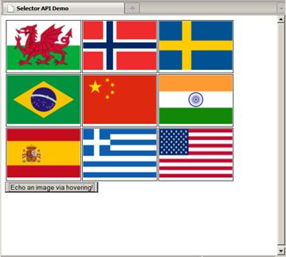
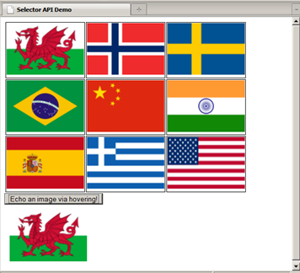
Example 1
Example of querySelector()
See QuerySelectorDemo.html
Notes:
This example shows how to use querySelector(). To run the demo, follow these steps:
Open QuerySelectorDemo.html in a browser.
Hit the TAB key until the input cursor is over the button.
Move your mouse so that it sits over one of the flags.
Then press ENTER to click the button. The JavaScript code detects the <td> cell that currently has the mouse hovering over it, and then copies the relevant flag into a placeholder panel on the Web page.

Slide 23
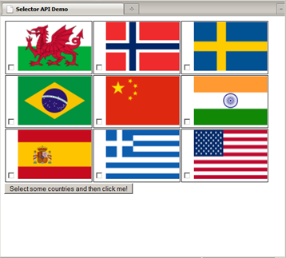
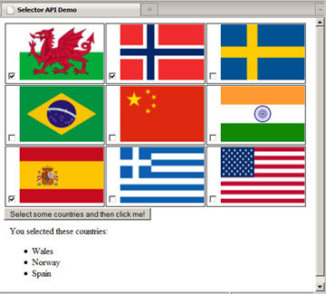
Example 2
Example of querySelectorAll()
See QuerySelectorAllDemo.html
Notes:
This example shows how to use querySelectorAll(). To run the demo, follow these steps:
Open QuerySelectorAllDemo.html in a browser.
Check some of the checkboxes.
Then click the button. The JavaScript code detects all the checkboxes that are currently checked, and displays the relevant country names in a bulleted list.

Slide 24
Summary
Setting the scene
Working with HTML documents
Using the HTML5 selector API
Notes:
That concludes the core content in this chapter. The remaining slides in the chapter provide some additional information about Modernizr, which you're welcome to peruse if you have time.

Slide 25
Annex: Using Modernizr
What is Modernizr?
Getting a custom build
Using the Modernizr object
Using Modernizr CSS classes

Slide 26

What is Modernizr?
Modernizr is a free JavaScript library that greatly simplifies the task of feature detection
http://www.modernizr.com/
Constantly updated
Detects:
All major HTML5 features
All major CSS3 features
Includes polyfills (i.e. emulation libraries) to mimic non-supported features
Widespread adoption
Twitter, US NFL, Burger King, …

Slide 27
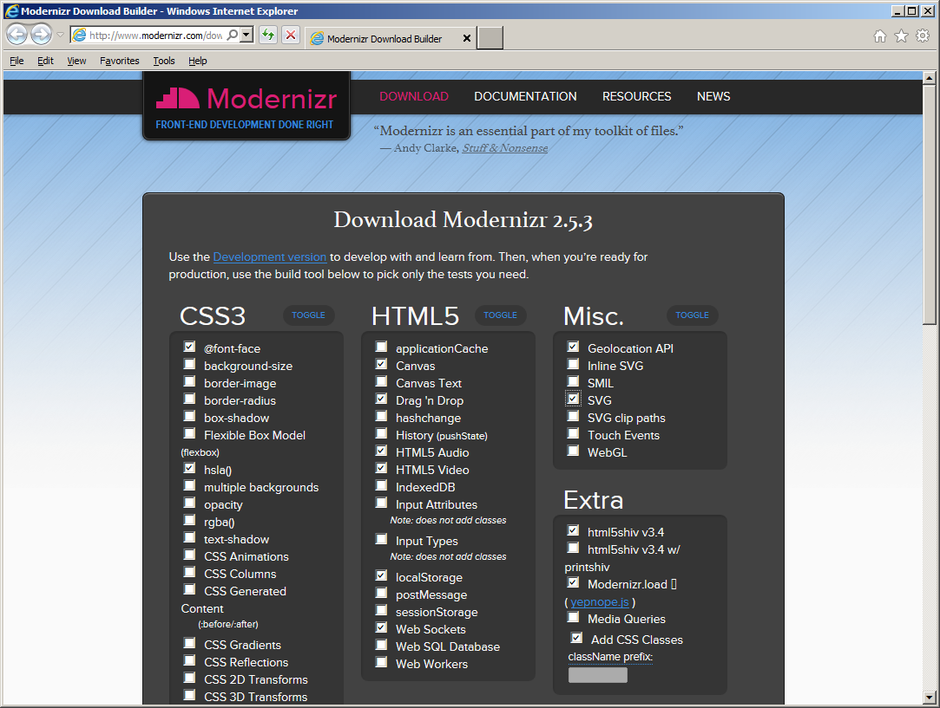
Getting a Custom Build

Slide 28
Using the Modernizr Object
Modernizr defines a JavaScript object named Modernizr
Properties indicate which HTML5/CSS3 features are supported
Example: ModernizrScriptExample.html
<script src="modernizr.js" type="text/javascript"></script>
<script type="text/javascript">
function onLoad() {
var messageAreaElem = document.getElementById("messageArea");
if (Modernizr.websockets) {
messageAreaElem.innerHTML = "Your browser does support Web Sockets";
messageAreaElem.style["color"] = "lightgreen";
}
else {
messageAreaElem.innerHTML = "Your browser does not support Web Sockets";
messageAreaElem.style["color"] = "red";
}
}
window.addEventListener("load", onLoad, true);
</script>

Slide 29
Using Modernizr CSS Classes
Modernizr adds various CSS classes to the <html> tag
Classes indicate which HTML5/CSS3 features are supported
Example: ModernizrCssExample.html
<style type="text/css">
div.ws, div.nows {
display: none;
font-size: 30pt;
}
.websockets div.ws {
display: block;
color: lightgreen;
}
.no-websockets div.nows {
display: block;
color: red;
}
</style>
<script src="modernizr.js" type="text/javascript"></script>
…
<div class="nows">Your browser does not support WebSockets.</div>
<div class="ws">Your browser does support WebSockets. </div>

Slide 30
Any Questions?

